Slide 1


UNIVERSITY OF ENGINEERING & MANAGEMENT,
KOLKATA University Area, Plot No. III – B/5, New Town, Action Area – III, Kolkata– 700160
Under the guidance of
Dr. Anirban Das
FLIGHT RESERVATION SYSTEM

Slide 2

SUBMITTED BY:-
NAME | ENROLLMENT NUMBER
Debangshu Acharyya | 12020004009006
Pritha Roy Chowdhury | 12020004009007
Subhamoy Kolya | 12020004009008
Subhoraj Saha | 12020004009009
Akash Ghosh | 12020004009010

Slide 3

CONTENTS | PAGE NO
Abstract | 4
Introduction | 5
Hardware and Development tools | 6
Flowchart | 7
Result | 8-14
Conclusion | 15

Slide 4
ABSTRACT:-
This project on Flight Reservation System is the automation of registration process of Flight Reservation System.
The system is able to :- i) Add passenger record. ii) View Passenger record. iii) Cancel Passenger record.

Slide 5
INTRODUCTION:-
The Flight Reservation System (FRS) is a online application to assist an flight with transactions related to making ticket reservations, which includes blocking, reserving, canceling and rescheduling tickets.
This mini project in Flight Reservation System is coded in C language. It uses files as database to perform file handling operations such as add, view and cancel records to manage passenger records.
The source code for this mini project is error-free. There are many places for improvements and enhancements within the project. This C mini project on Flight Reservation System is compiled in Visual Studio Code IDE using GCC compiler.

Slide 6
HARDWARE AND DEVELOPMENT TOOL
Hardware:
CPU configuration
• AMD RYZEN 5 3500H CPU @ 2.10GHz
• RAM-8GB DDR4
Monitor
• 16.1 inches
Operating System
• Windows 10
Development Tool:
• VS code

Slide 7
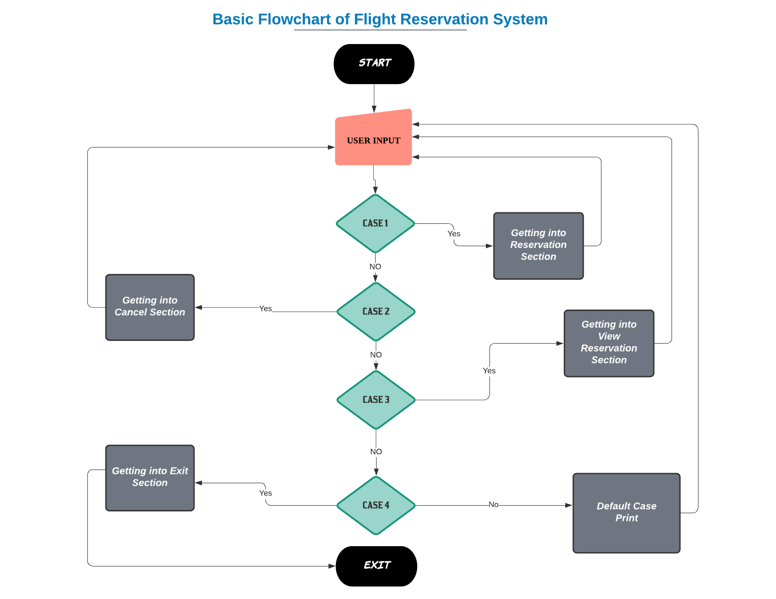
FLOWCHART

Slide 8
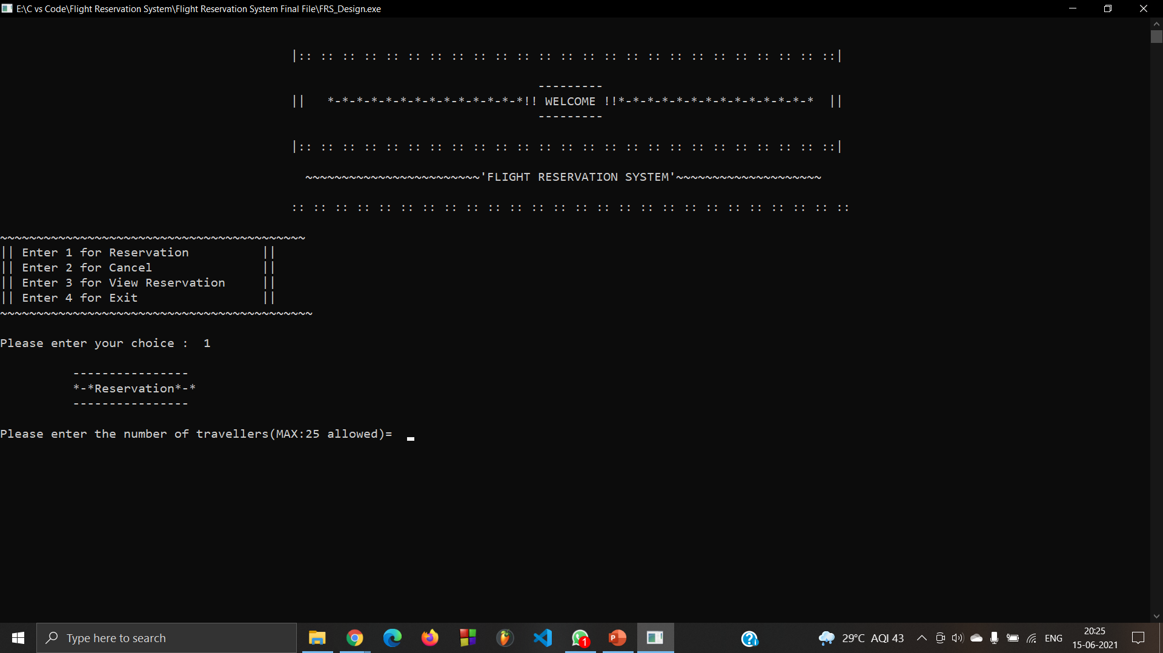
OUTPUTS RECORD:-

Slide 9
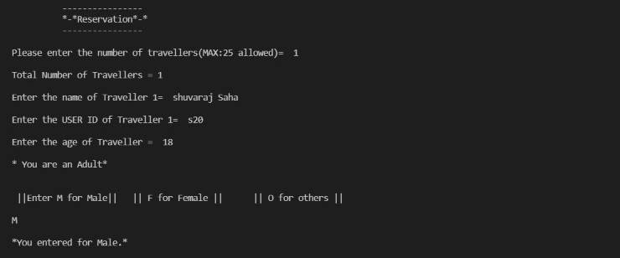
RESERVATION RECORD:-

Slide 10
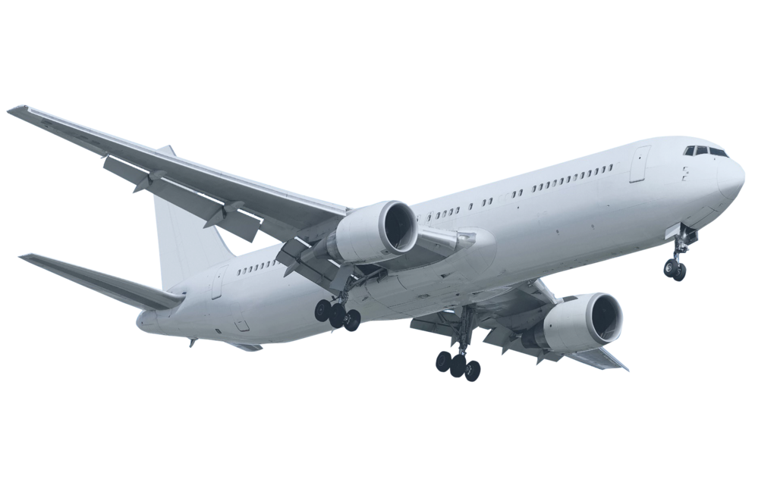
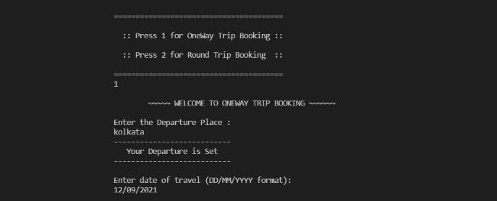

ONE WAY TRIP BOOKING RECORD:-

Slide 11
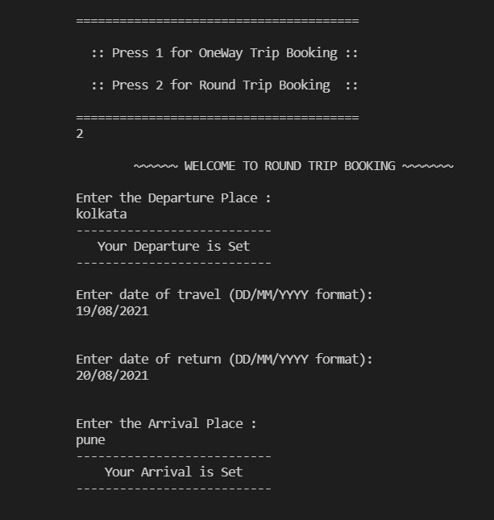
ROUND TRIP BOOKING RECORD:-

Slide 12
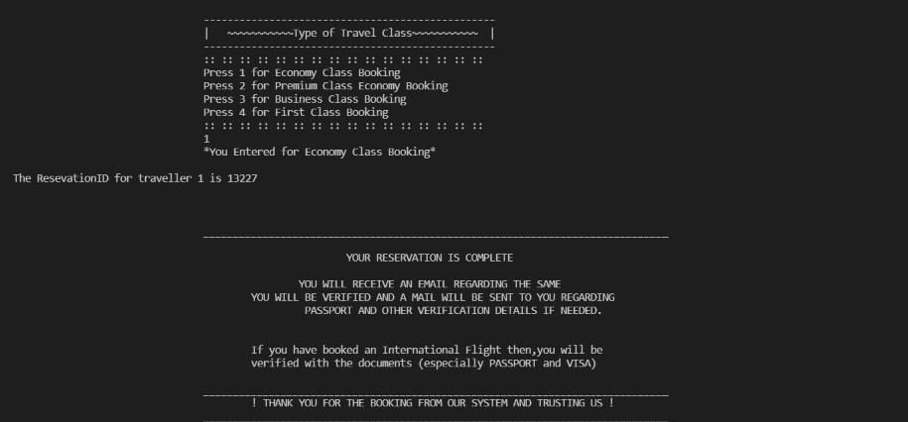
BOOKING RECORD:-

Slide 13
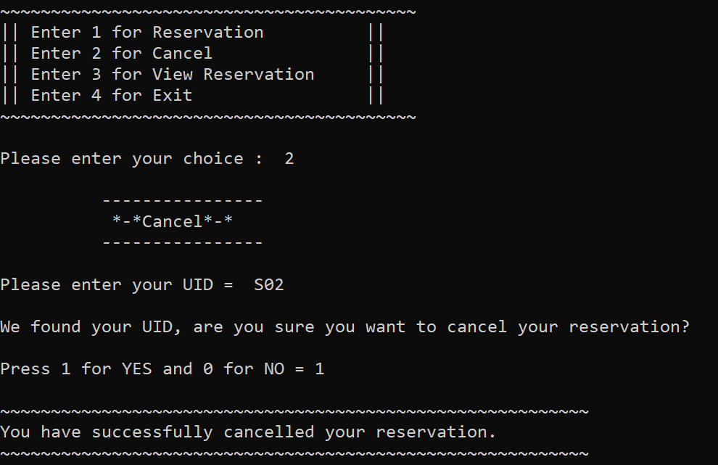
CANCELLATION RECORD:-

Slide 14
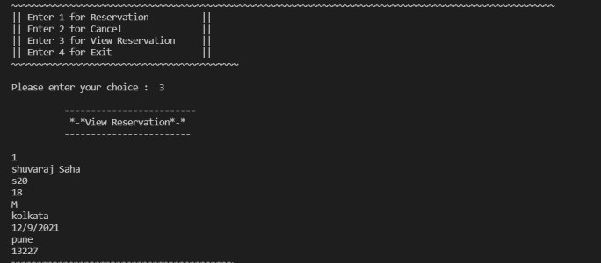
VIEW RESERVATION RECORD:-

Slide 15
CONCLUSION:-
It can be operated very easily. There is no need to recruit extra dedicated person or equipment to this application.
As it provides very high level user friendly function.
Though we already added many features but there can be some changes made in Search Reservation to make it more efficient.

Slide 16

THANK YOU !

